Slide 1

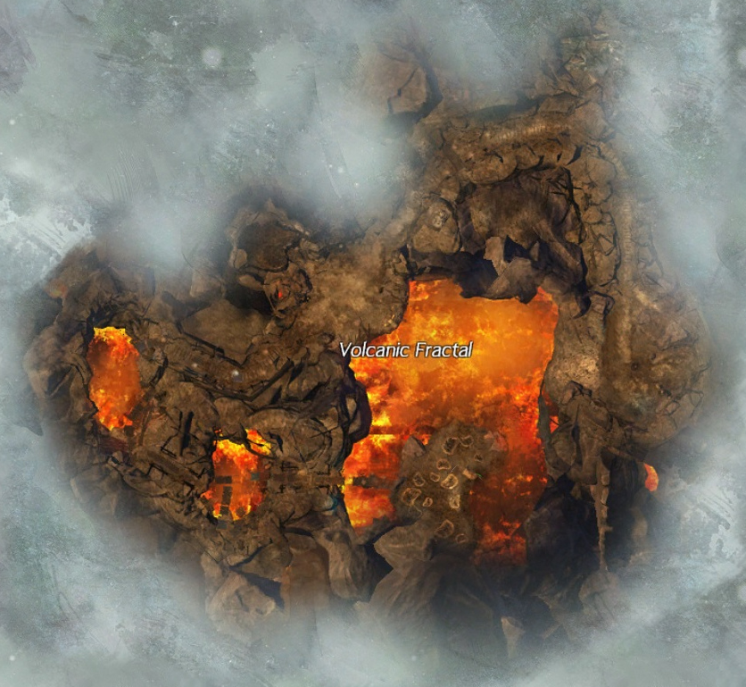
Volcanic Fractal
Scales:
1, 19, 28, 52, 92
Know What to Expect:
Mechanics explained Step-By-Step
By: Michie.4352

Slide 2
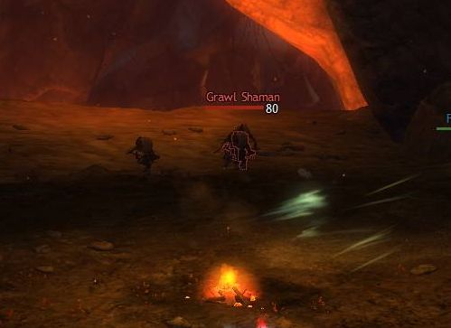
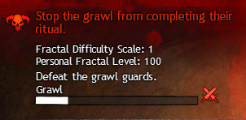
1. Kill: Stop the Grawl from Completing the Ritual
Kill waves of Adds to Stop the Grawl!
You can check on the top right corner of your screen to see your progress

Slide 3
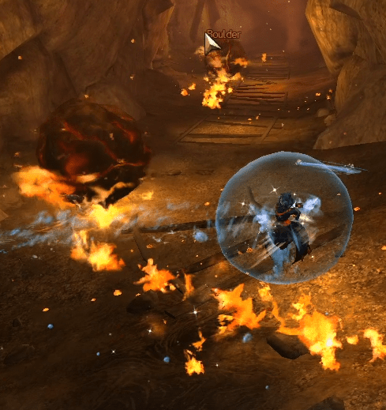
2. Pop-up Scene: Rolling Meteors
Rolling meteors will roll down the cave, leaving a trail of fire behind them for a few seconds. You want to run through without getting rolled over because that’s an instant down/K.O.
1st hit: Instant Down
2nd Hit: K.O.
Best way is run behind the meteors but next to the fire, so you don’t get a burning effect

Slide 4
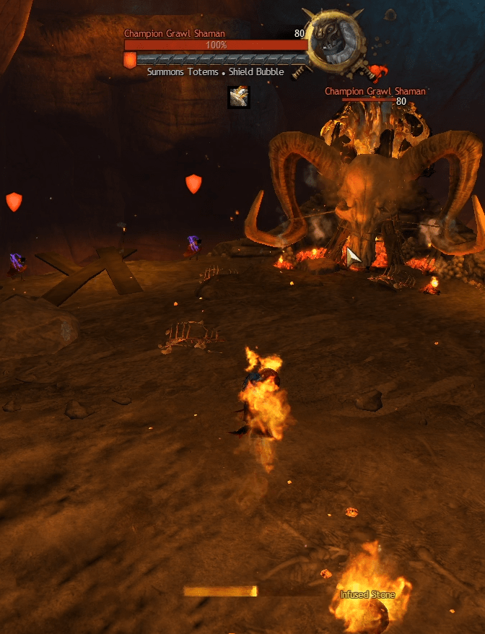
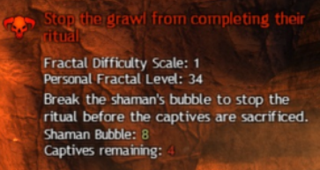
3. Mini Boss/Game:
Protect Villagers Pt. 1
Four Villagers on the corners next to the Boss that’s on top of a Skull Head – Protect them from being pushed off the edge by Adds
  If all four villagers are pushed off, you’ll have to restart all over again
  Best Strategy: Kill the Adds walking towards the Villagers. You can use slows to give you and your party more time to kill.
At the same time, you see the mini boss with a protective shield on top of a skull head and infused stones on the ground
  Best Strategy: Split up. Half of the group focuses on Adds and the other half focus on grabbing the infused stones and throw it at the Champ.
  You can see on the top right corner of your screen just how many stones you need to throw to break the shield

Slide 5
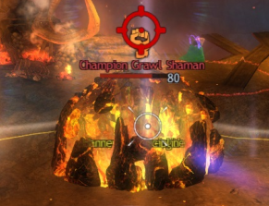
4. Mini Boss/Game:
Champion Grawl Shaman Pt. 2
The Boss will come down the skull head and start attacking. Have the party stay right in front of the skull head so you can make sure the Champ won’t be able to knock you off the surface.
You’ll want to watch out for a big AOE under the boss. It comes out randomly so look for when it’s going to happen because another circle will come out of the boss, getting bigger until it touches the original AOE circle. That’s when you’ll want to stay out of the AOE by dodging last second.
From time to time, the shield will pop up again! Which means one teammate, or you will have to pick up a stone and throw it at the boss. That’s the only way you can break the Shield. Soon after, either attack to kill or CC to attack

Slide 6
5. Jumping Puzzle
It’s very short that doesn’t really count as a Jumping Puzzle, but you can get an achievement for not touching the lava by going through the puzzle.

Slide 7
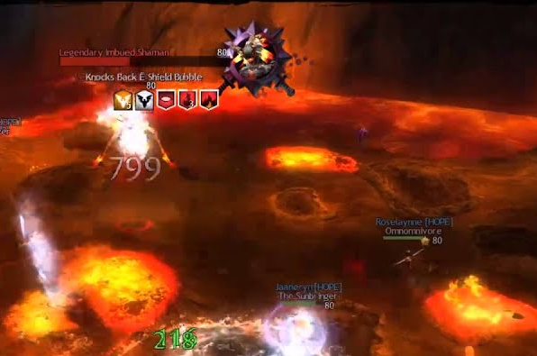

6. Final Boss: Caldera Pt. 1
  There are Holes around the surface surrounded by lava. Watch out for them because the lava will fill it up and deal damage if you stand in it.
  Once you step on the surface, you’ll start getting a burning effect that will continuously stack until you K.O., but you can avoid this by constantly running around.

Slide 8
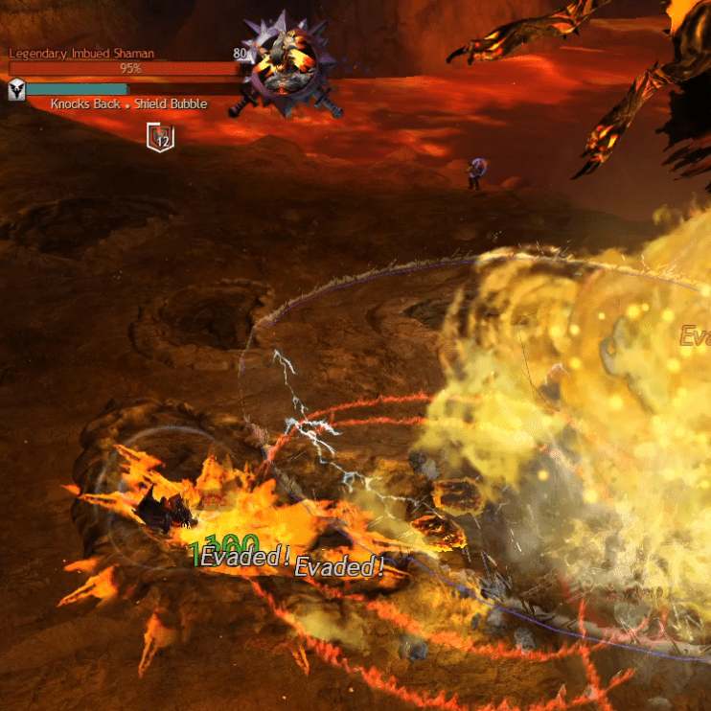
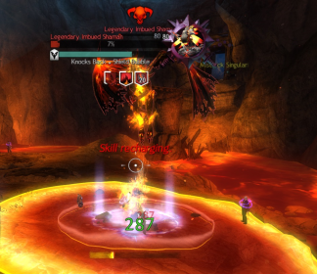
7. Final Boss: Caldera Pt. 2
There are two main Mechanics to watch out for:
  1. A Big red AOE under the boss where there will be another AOE getting bigger and bigger until it touches the outer red AOE. When it touches, you’ll want to stay out of it. You can either dps and then dodge out at the last second or you can move backwards until you are out of the AOE but still attack ranged.
  2. When the Boss flies upwards and comes straight back down. When you see the Boss come down, dodge out last second. That’s how you can avoid a Multi-Lava AOE that stays on the ground for a few seconds.

Slide 9
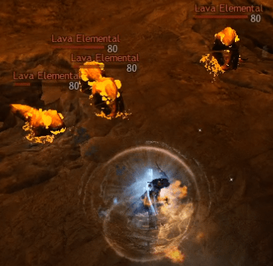
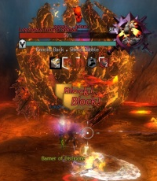
8. Final Boss: Caldera Pt. 3
Now repeat the Mechanics until you’ve killed the final boss!!
Phases: There are three phases at 75%, 50%, and 25%.
This is where the boss will put up a lava shield and fly over to a villager. While the boss flies over, there will be lava elementals that will also deal damage to you so make sure to deal with those elementals. If the Boss gets to the villager, it will kill the villager and gain back the health it just lost.
  Best Strategy: DPS!!! As Much As You Can!! Until the shield breaks. You can have one player focus on killing the elementals while have the rest of the group go full out DPS rotations to break the shield before it gets to a Villager.
  There is no end to the Villagers! If you have already gone through 4 Villagers, they will just keep on popping up so make sure you break the shield so the boss doesn’t heal up!

Slide 10
Good Luck
If you have any Questions, Feel Free To DM me

